Slide 1
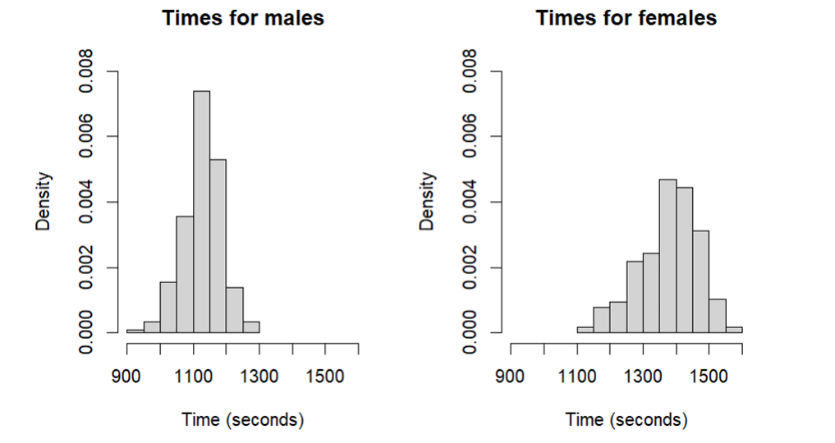
Comparison of male and female times
Fig 2.1: Histogram of Fastest Male and Female Participants
Fig 2.2: Summary of Male and Female Runner statistics
Gender | Mean | Standard deviation
Male | 1129 | 59
Female | 1380 | 89

Slide 2
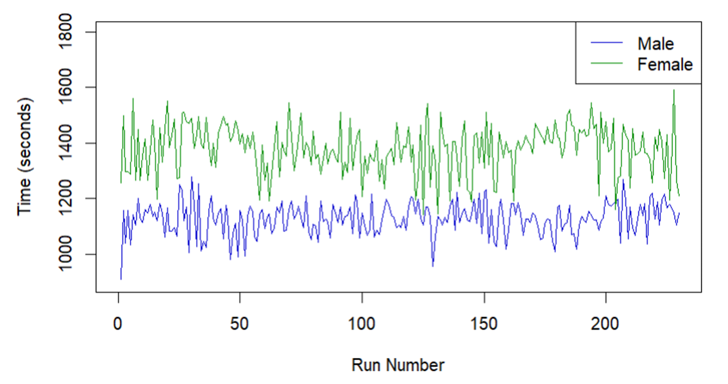
Demonstrating Changes Over Time
Fig 3.1: Line Graph showing the run number against the time taken

